Slide 1
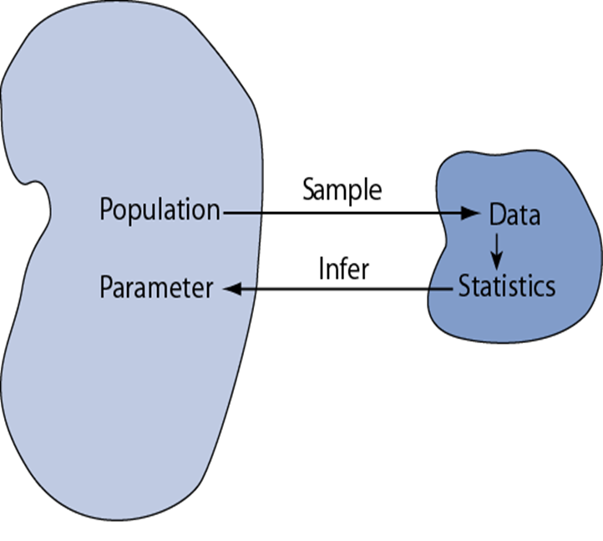
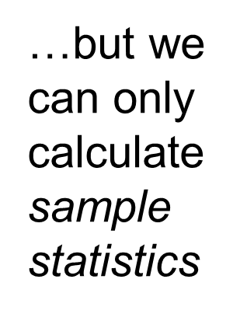
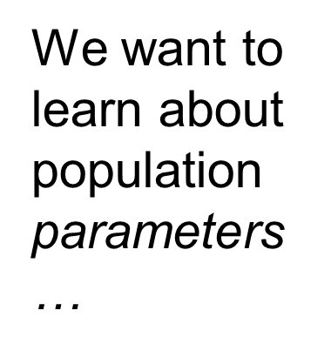
Statistical Inference
Statistical inference is the process of reaching conclusions about characteristics of an entire population using data from a subset, or sample, of that population. Therefore, Statistical inference is the act of generalizing from a sample to a population with calculated degree of certainty.

Slide 2
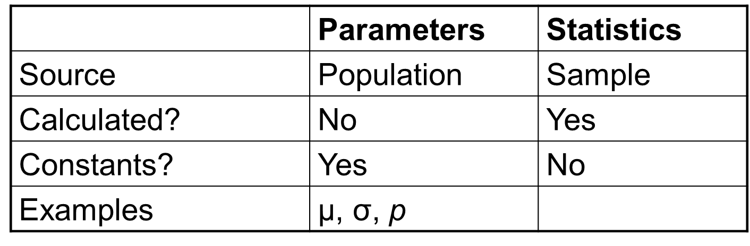
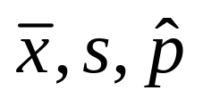
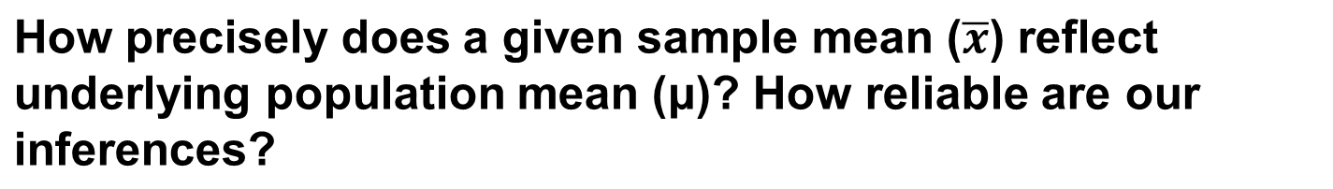
Statistical Inference
It is essential to make the distinctions between parameters and statistics

Slide 3
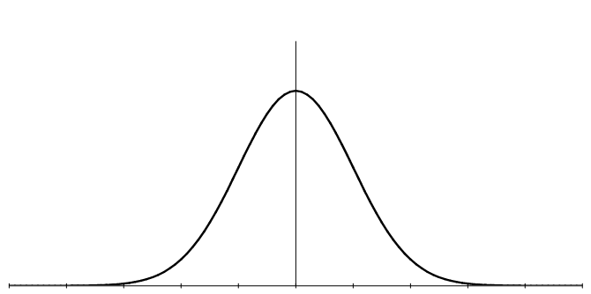
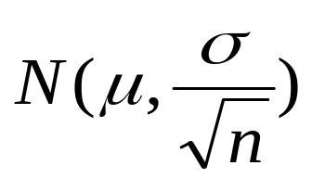

Sampling Distribution-Mean
Mean calculated from a sample is usually the best guess for population mean. But different samples give different sample means!
It can be shown that sample means from samples of size n are normally distributed:
Term is called standard error (standard deviation of sample means).

Slide 4
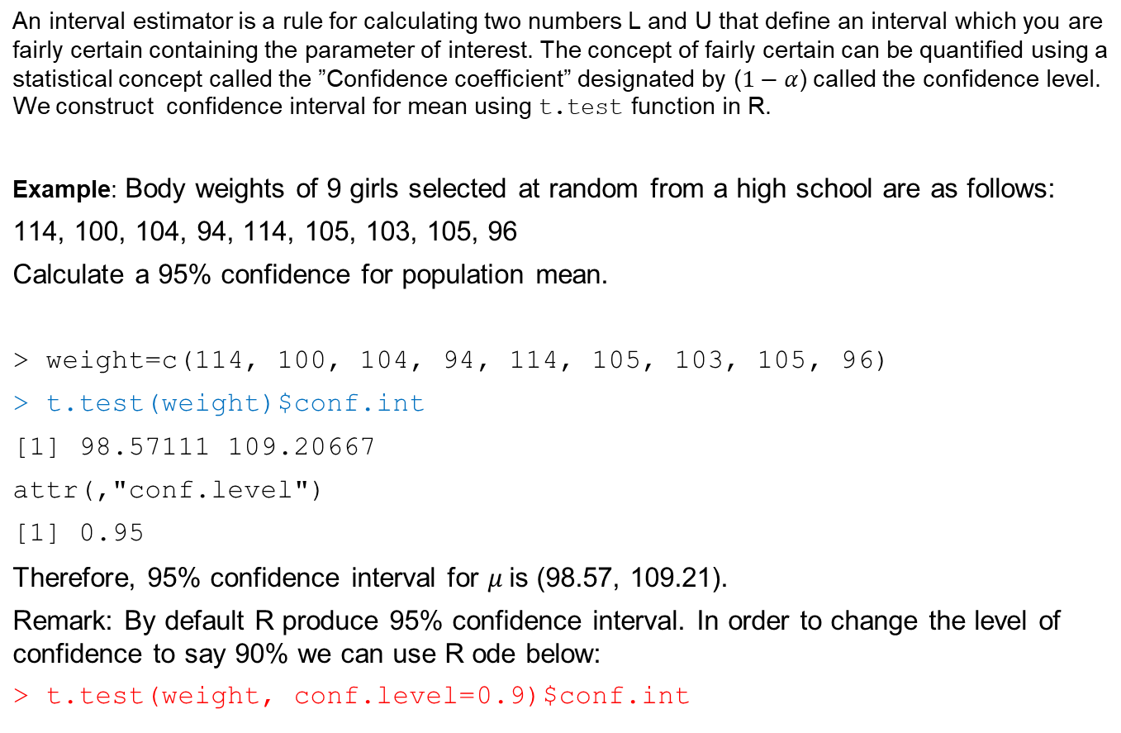
Confidence Interval- Single sample

Slide 5
Confidence Interval - two sample
Example: Construct a 95% confidence interval for difference in the mean of two groups
Group 1: 15, 10, 13, 7, 9, 8, 21, 9, 14, 8
Group 2: 15, 14, 12, 8, 14, 7, 16, 10, 15, 12
> x = c(15, 10, 13, 7, 9, 8, 21, 9, 14, 8)
> y = c(15, 14, 12, 8, 14, 7, 16, 10, 15, 12)
> t.test(x,y)$conf.int
[1] -4.474425 2.674425
attr(,"conf.level")
[1] 0.95
To change the level of confidence we use
t.test(data1,data2, conf.level=“”)$conf.int

Slide 6
Confidence Interval for proportion
We can use binom.test to construct confidence interval for proportion
Example: An airline claims that, on average, 5% of its flights are delayed each day. On a given day, of 500 flights, 50 are delayed. Test the hypothesis that the average proportion of delayed flights is 5% at the 0.01 level.
> binom.test(50,500,p=0.05)$conf.int
[1] 0.07513582 0.12970909
attr(,"conf.level")
[1] 0.95
To change the confidence level to 90% we use R code below
> binom.test(50,500,p=0.05, conf.level=0.9)$conf.int
[1] 0.07873857 0.12486581
attr(,"conf.level")
[1] 0.9

Slide 7
Confidence Interval for two sample proportion
We can use prop.test to perform two sample proportion test.
Example: A random sample of 428 adults from Myrtle Beach reveals 128 smokers. A random sample of 682 adults from San Francisco reveals 170 smokers. Calculate 90% confidence interval for the difference in the proportion.
> prop.test(x=c(128,170), n=c(428,682))$conf.int
[1] -0.006283211 0.105880328
attr(,"conf.level")
[1] 0.95
We can use R code below to change the confidence interval to 90%
> prop.test(x=c(128,170), n=c(428,682), conf.level=0.9)$conf.int
[1] 0.002427565 0.097169552
attr(,"conf.level")
[1] 0.9

Slide 8
Hypothesis Testing
The hypothesis testing procedure is a method for choosing between two competing hypotheses the so-called null hypothesis (Ho) and alternative
hypothesis(Ha).
Null Hypothesis (Ho ): A null hypothesis is a claim (or statement) about a
population parameter that is assumed to be true until it is declared false.
Alternative Hypothesis(Ha): An alternative hypothesis is a claim about
population parameters that will be true if the null hypothesis is false

Slide 9




Hypothesis testing
Statistical inference
Sample
Null hypothesis
Alternative hypothesis

Slide 10
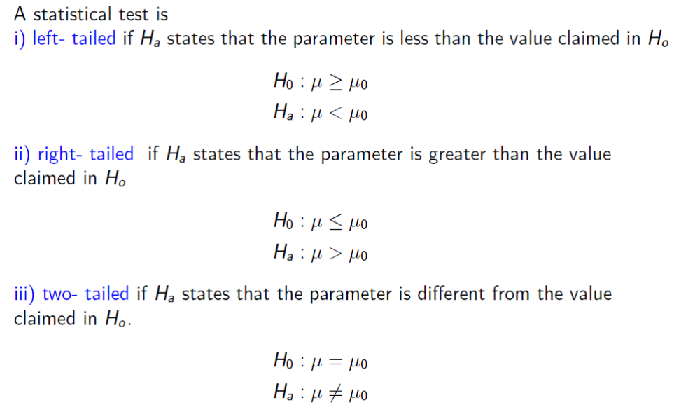
Types of Statistical Tests

Slide 11
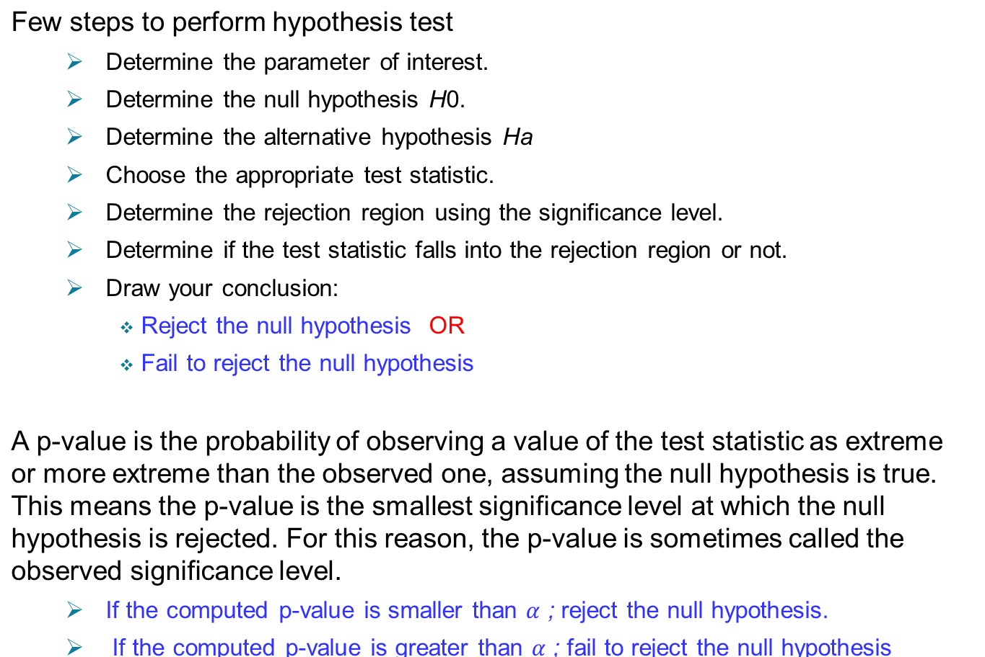
Performing hypothesis tests

Slide 12
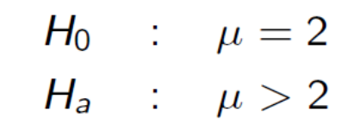
Hypothesis Testing- Single sample
Example: A farmer wants to test if a new brand of fertilizer increases his wheat yield per plot. He put the new fertilizer on 15 equal plots and records the yields for the 15 plots which are given below. If his traditional yield is two bushels per plot, conduct a test of significance for significance level.
2.5,3.0,3.1,4.0,1.2,5.0,4.1,3.9,3.2,3.3,2.8,4.1,2.7,2.9,3.7
Solution: We would like to test
> x=c(2.5,3.0,3.1,4.0,1.2,5.0,4.1,3.9,3.2,3.3,2.8,4.1,2.7,2.9,3.7)
> t.test(x, alternative="greater", mu=2)
One Sample t-test
data: x
t = 5.6443, df = 14, p-value = 3.026e-05
alternative hypothesis: true mean is greater than 2
Based on the p-value we reject the null hypothesis and conclude that the new brand of fertilizer increases the wheat yield.

Slide 13
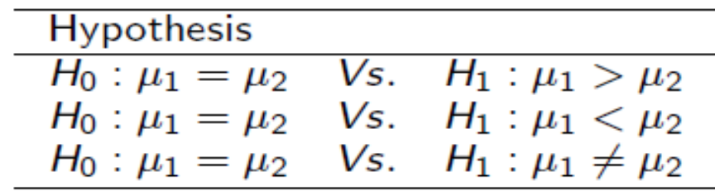
Comparing two population Means
We may be interested in comparing two population means and perform on of the following test
Depending on whether these samples are paired or not we should perform two sample t-test (Welch test) or paired t-test. Also we may apply the option of whether or not the variances of both population are equal.
The R code to perform two sample t-test is
t.test(data1, data2, alt=“.”, var.equal=“.”, paired=“.”)

Slide 14
Example-Paired t-test
A study was performed to test whether cars get better mileage on premium gas than on regular gas. Each of 10 cars was first filled with either regular or premium gas, decided by a coin toss, and the mileage for that tank was recorded. The mileage was recorded again for the same cars using the other
kind of gasoline.
> Premium = c(19, 22, 24, 24, 25, 25, 26, 26, 28, 32)
> Regular = c(16, 20, 21, 22, 23, 22, 27, 25, 27, 28)
> t.test(Premium,Regular, alternative="greater", paired=TRUE)
Paired t-test
data: Premium and Regular
t = 4.4721, df = 9, p-value = 0.0007749
alternative hypothesis: true difference in means is greater than 0
Decision: Reject the null hypothesis. There is strong evidence of a mean increase in gas mileage between regular and premium gasoline.
Car | 1 | 2 | 3 | 4 | 5 | 6 | 7 | 8 | 9 | 10
Premium | 19 | 22 | 24 | 24 | 25 | 25 | 26 | 26 | 28 | 32
Regular | 16 | 20 | 21 | 22 | 23 | 22 | 27 | 25 | 27 | 28

Slide 15
Example-Two sample t test
Suppose the recovery time for patients taking a new drug is measured (in days). A placebo group is also used to avoid the placebo effect. The data are as follows. Perform the test to show that the drug group has smaller mean.
Assume equal variance of both groups
> x = c(15, 10, 13, 7, 9, 8, 21, 9, 14, 8)
> y = c(15, 14, 12, 8, 14, 7, 16, 10, 15, 12)
> t.test(x,y,alt="less",var.equal=TRUE)
Two Sample t-test
data: x and y
t = -0.5331, df = 18, p-value = 0.3002
alternative hypothesis: true difference in means is less than 0
Decision: Not enough evidence to reject the null hypothesis.
Drug | 15 | 10 | 13 | 7 | 9 | 8 | 21 | 9 | 14 | 8
Placebo | 15 | 14 | 12 | 8 | 14 | 7 | 16 | 10 | 15 | 12

Slide 16
Hypothesis testing for proportion
An airline claims that, on average, 5% of its flights are delayed each day. On a given day, of 500 flights, 50 are delayed. Test the hypothesis that the average proportion of delayed flights is more than 5% at the 0.01 level.
> binom.test(50,500,alternative="greater",p=0.05)
Exact binomial test
data: 50 and 500
number of successes = 50, number of trials = 500, p-value = 3.576e-06
alternative hypothesis: true probability of success is greater than 0.05
95 percent confidence interval:
0.07873857 1.00000000
sample estimates:
probability of success
0.1
Decision: Reject the null hypothesis and conclude that there is enough evidence to conclude that the proportion of delayed flights is more than 5%.

Slide 17
Hypothesis testing for two sample proportion
A random sample of 428 adults from Myrtle Beach reveals 128 smokers. A random sample of 682 adults from San Francisco reveals 170 smokers. Is the proportion of adult smokers in Myrtle Beach different from that in San Francisco? Use 0.05 level of significance.
> prop.test(x=c(128,170), n=c(428,682))
2-sample test for equality of proportions with continuity correction
data: c(128, 170) out of c(428, 682)
X-squared = 3.0718, df = 1, p-value = 0.07966
alternative hypothesis: two.sided
95 percent confidence interval:
-0.006283211 0.105880328
sample estimates:
prop 1 prop 2
0.2990654 0.2492669
Decision: Fail to reject the null hypothesis. Tis means we have no enough evidence to conclude that the proportion of adult smokers in Myrtle Beach is different from that in San Francisco.

Slide 18
Chi-Squared test for Goodness of fit
The chi-square test for goodness-of-fit uses frequency data from a sample to test hypotheses about the shape or proportions of a population.
Each individual in the sample is classified into one category on the scale of measurement.
The data, called observed frequencies, simply count how many individuals from the sample are in each category.
The null hypothesis specifies the proportion of the population that should be in each category.
The proportions from the null hypothesis are used to compute expected frequencies that describe how the sample would appear if it were in perfect agreement with the null hypothesis

Slide 19
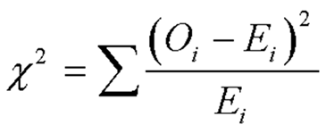
Chi-squared test for goodness of fit
Make a hypothesis based on your basic biological question
Determine the expected frequencies
Create a table with observed frequencies, expected frequencies, and chi-square values using the formula:
Find the degrees of freedom: (c-1)(r-1)
Find the chi-square statistic in the Chi-Square Distribution table
Compare the test and make a decision.

Slide 20
Example
Are emergency calls equally distributed across all days of the week?
Sample data for several weeks has been collected:
  We would like to test
  H0: The distribution of calls is uniform over days of the week
  Ha: The distribution of calls is not uniform
>call=c(290,250,238,257,265,230,192)
> chisq.test(call)
Chi-squared test for given probabilities
data: call
X-squared = 23.0488, df = 6, p-value = 0.0007803
Since p<α we reject the null hypothesis
Sunday | Monday | Tuesday | Wednesday | Thursday | Friday | Saturday
290 | 250 | 238 | 257 | 265 | 230 | 192

Slide 21
Example
A cross between white and yellow summer squash gave progeny of the following colors
Are these data consistent with the 12 : 3 : 1 ratio predicated by a certain
genetic model?
H0 : the model is correct with proportion of 12: 3: 1
Ha : The model is incorrect (the proportion are not as specified by above)
> x=c(155,40,10)
> p=c(12/16,3/16,1/16)
> chisq.test(x,p=p)
Chi-squared test for given probabilities
data: x
X-squared = 0.6911, df = 2, p-value = 0.7078
Decision: We fail to reject the null hypothesis and conclude that the colors are consistent with the genetic model with given proportions.
Color | White | Yellow | Green
Number of progeny | 155 | 40 | 10

Slide 22
Contingency Tables
Contingency Tables
Used to classify sample observations according to a pair of attributes
Also called a cross-classification or cross-tabulation table
Assume r categories for attribute A and c categories for attribute B
  Then there are (r x c) possible cross-classifications

Slide 23
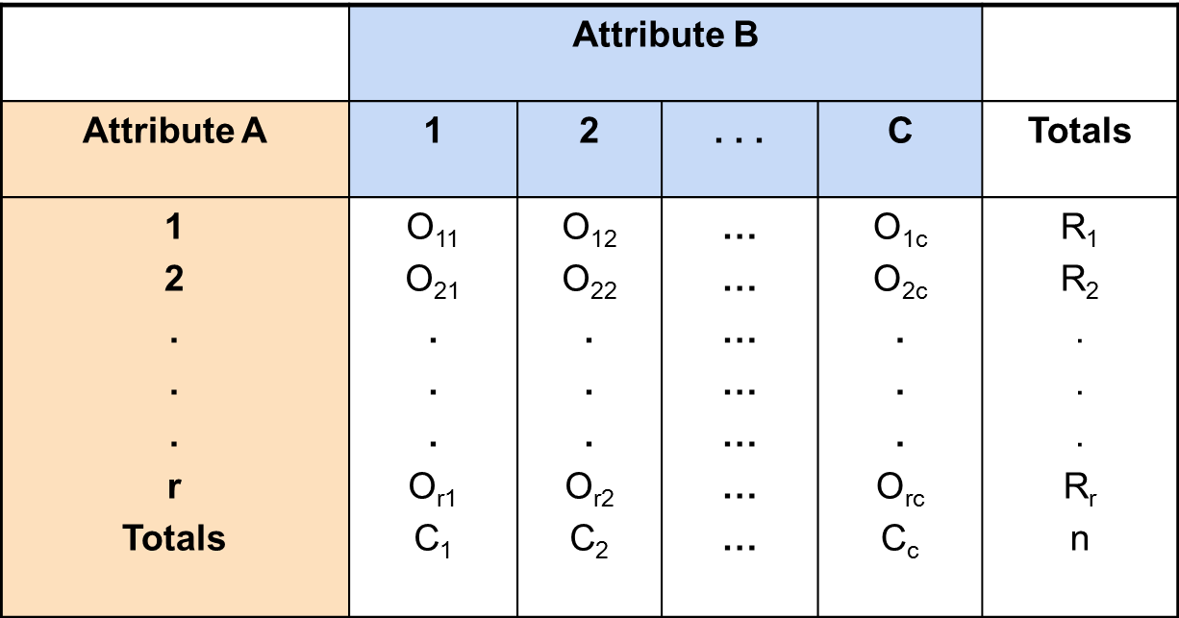
r x c Contingency Table

Slide 24

Test for Association
Consider n observations tabulated in an r x c contingency table
Denote by O_{ij} the number of observations in the cell that is in the i^{th} row and the j^{th} column
The null hypothesis is
The appropriate test is a chi-square test with
(r-1)(c-1) degrees of freedom

Slide 25
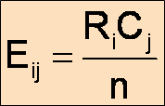
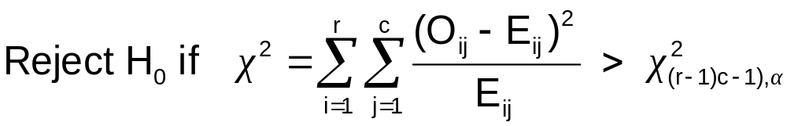
Test for Association
Let R_{i} and C_{j} be the row and column totals
The expected number of observations in cell row i and column j, given that H₀ is true, is
A test of association at a significance level α is based on the chi-square distribution and the following decision rule

Slide 26
Contingency Table-Example
Left-Handed vs. Gender
Dominant Hand: Left vs. Right
Gender: Male vs. Female
H₀: There is no association between
hand preference and gender
H₁: Hand preference is not independent of gender

Slide 27
Contingency Table- Example
Sample results organized in a contingency table:
sample size = n = 300:
Gender | Hand Preference
 | Left | Right
Female | 12 | 108 | 120
Male | 24 | 156 | 180
 | 36 | 264 | 300
120 Females, 12 were left handed
180 Males, 24 were left handed

Slide 28
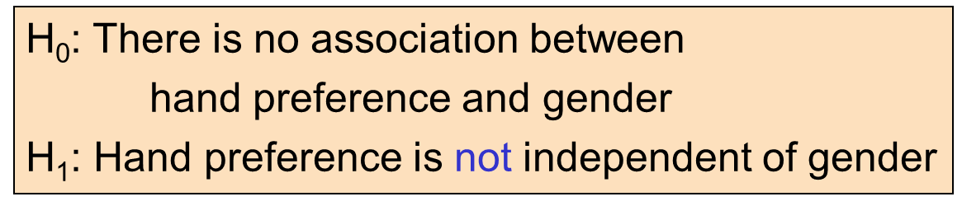
Contingency Table-Example
If H₀ is true, then the proportion of left-handed females should be the same as the proportion of left-handed males
The two proportions above should be the same as the proportion of left-handed people overall

Slide 29
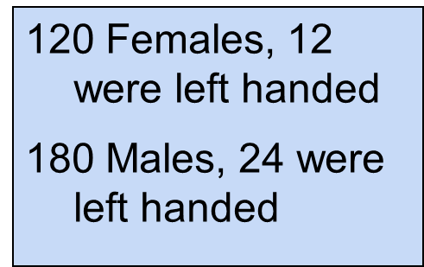
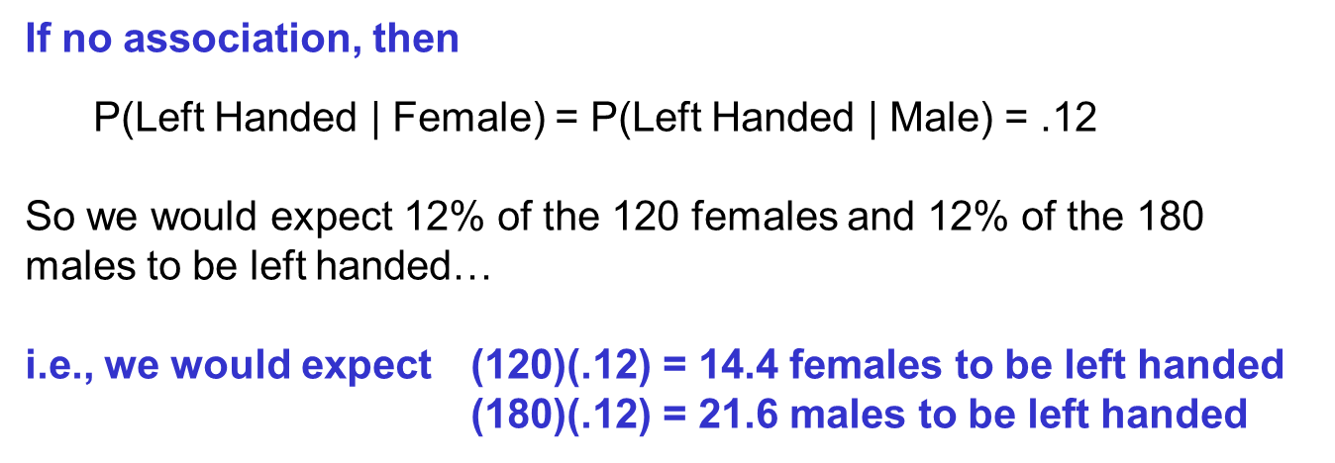
Example- Dominant Hand
Overall:
P(Left Handed)
= 36/300 = .12

Slide 30
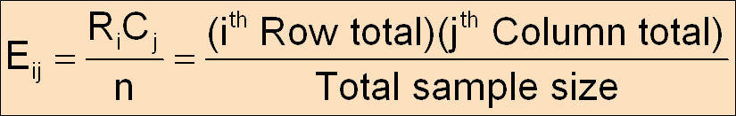
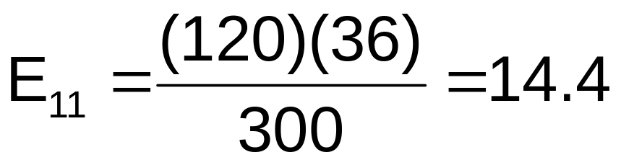
Example-Dominant hand
Expected cell frequencies:

Slide 31
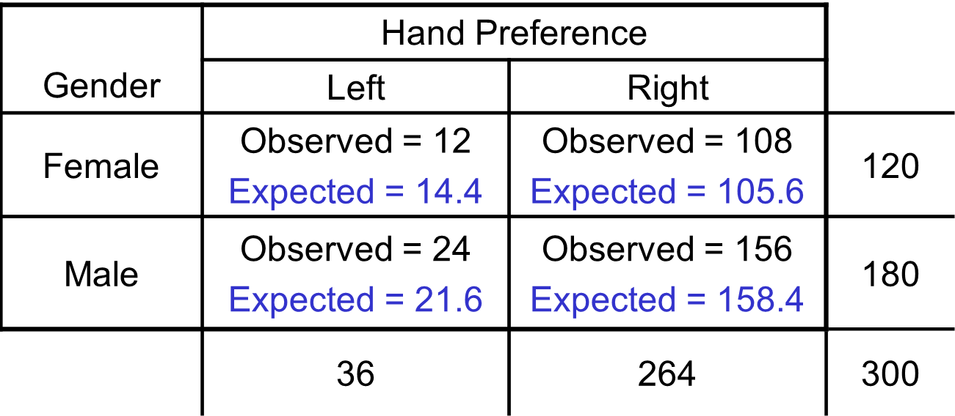
Example-Dominant hand
Observed frequencies vs. expected frequencies

Slide 32
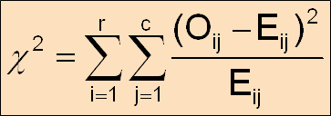

The Chi-Square Test Statistic
The Chi-Square Test Statistic is
where:
O_{ij} = observed frequency in cell (i, j)
E_{ij} = expected frequency in cell (i, j)
r = number of rows
c = number of columns

Slide 33
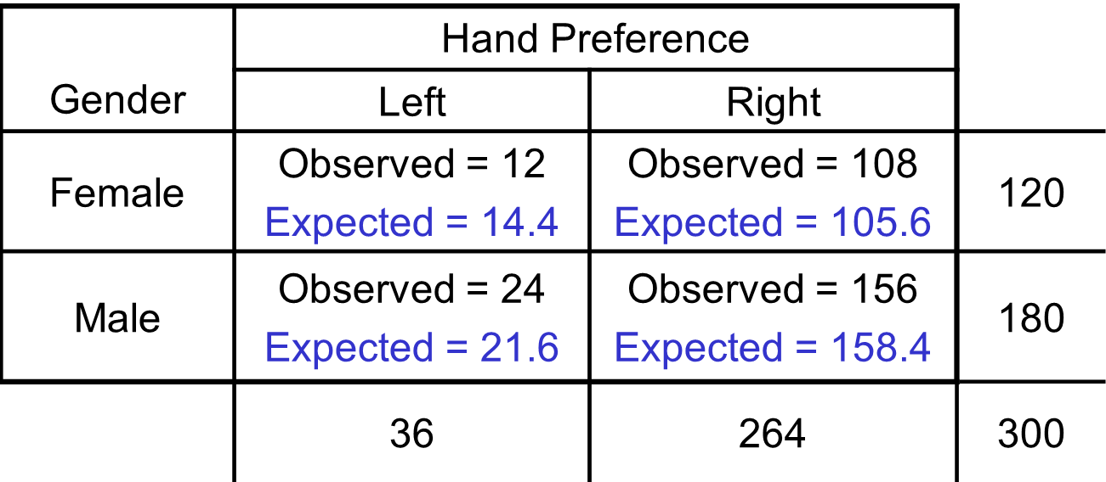
Decision Rule:
If χ² > 3.84, reject H₀, otherwise, do not reject H₀
Here, χ² = 0. < 3.841, so we
do not reject H₀ and conclude that gender and hand preference are not associated

Slide 34
Use R
> Female=c(12,108)
> Male=c(24,156)
> data=rbind(Female, Male)
> chisq.test(data, correct=F)
Pearson's Chi-squared test
data: data
X-squared = 0.7576, df = 1, p-value = 0.3841

Slide 35
Thank you

